Slide 1
FIT.KOVAI HACKATHON

Slide 2
Team Details
Title | Details
Team Name : | The Crew
Team SPOC: | Houshic B 3rd Year, Computer Science Engineering houshic.2001054@srec.ac.in +91 8056733377
Team Members: | Ajaykumar A 3rd Year, Computer Science Engineering ajaykumar.2001009@srec.ac.in +91 9952795040 Anisha S 3rd Year, Computer Science Engineering anisha.2001018@srec.ac.in +91 9500895068 Mohit M B 3rd Year, Computer Science Engineering mohit.2001123@srec.ac.in +91 9585849085

Slide 3

AGENDA
1. Problem definition
2. Abstract
3. Approach and technology used
4. Flow Chart
5. Future scalability view
6. Parameters
7. References

Slide 4
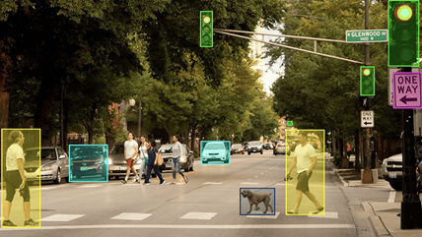
Problem definition
Our understanding towards the problem statement is to create a computer vision-based system that can find and follow things on highways and roads.
The system ought to be able to recognize all different kinds of vehicles and objects, including people, bicycles, and other obstructions, and track their motion in real time.
The system should be able to interpret 2D images taken by cameras placed on roads and offer precise details about the objects observed, including their location, speed, and direction of movement.
This intelligence can be used to increase public safety, reduce accidents
and optimize traffic flow.

Slide 5
ABSTRACT
Important computer vision tasks include the detection of objects and vehicle traffic for a variety of applications, including autonomous driving, security monitoring, and traffic management.
In this initiative, we provide a method for detecting objects and vehicle traffic in real-time using computer vision algorithms.
To train our model and carry out detection using deep learning techniques, we need a dataset of 2D images.
Modern object detection techniques are used to identify vehicles and other things, and our suggested solution entails tracking their motion over time.
The outcome of our system may be observed using an interactive web-based interface that displays object and traffic movement in real-time inside the monitored region.
Our method offers a reliable and practical solution for real-time object and vehicle detection.

Slide 6

Selection of algorithm
YOLO v7
YOLO v7 is an algorithm which is used for real time object detection
Application which use object detections models include video analytics, taking an image as input and then predicting bounding boxes
YOLO is much faster than object detectors for real time computer vision applications
It has a more streamlined architecture that reduces the number of computations needed for object detection, resulting in faster processing times.
It also has better accuracy, achieving state-of-the-art performance on several object detection benchmarks.

Slide 7
Approach and technology used
Firstly, the dataset of the 2D images needs to be pre-processed to prepare it for training the model. It involves labelling the objects and augmenting the data by transformations.
An object detection model for preprocessed data is done by using YOLO V7 which is one of the fastest and most accurate real time object detection model for computer vision tasks . After getting the model trained, the application can be developed.
Frontend is responsible for accepting images and displaying results using a responsive and interactive web page to upload images and display object detection results
Back end for web application will be responsible for processing , uploading and running detection model and suitable for us by using python integrated with flask.
To integrate model in the application we use computer vision libraries to process image and detect object

Slide 8
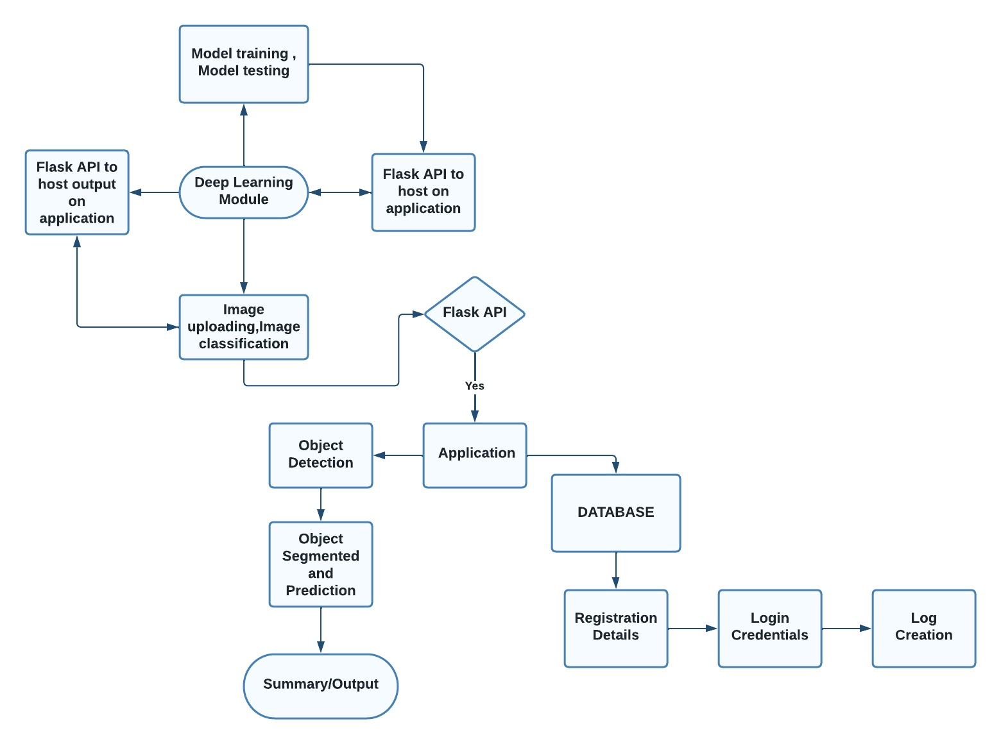
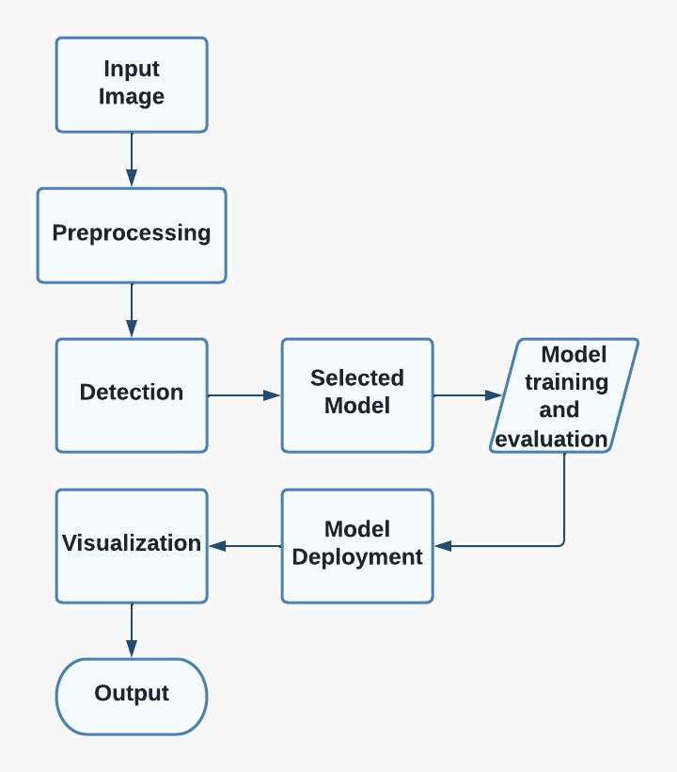
FLOW CHART

Slide 9
Parameters
Resolution
Size of the image
Width
Feature pyramids
Future scalability view
Real time view of objects in 2D images can be further initiated to real time video capturing (3D images)
which improves traffic flow, enhance security and increase public safety.
Application can be customized to meet specific needs such as traffic management agencies, Law enforcement agencies, transportation companies and autonomous vehicle manufacturers.
References
https://scholarworks.gvsu.edu/cgi/viewcontent.cgi?article=1916&context=theses
https://www.v7labs.com/blog/yolo-object-detection
https://forms.office.com/pages/responsepage.aspx?id=GR7lCsgHS067bWSO5YQQ9DOtow0KQwNCrz_XFL8LgaBUODZPQ09FTlpDOEQwQ0lZQVFTVVNDVTVOQS4u&origin=QRCode

Slide 10
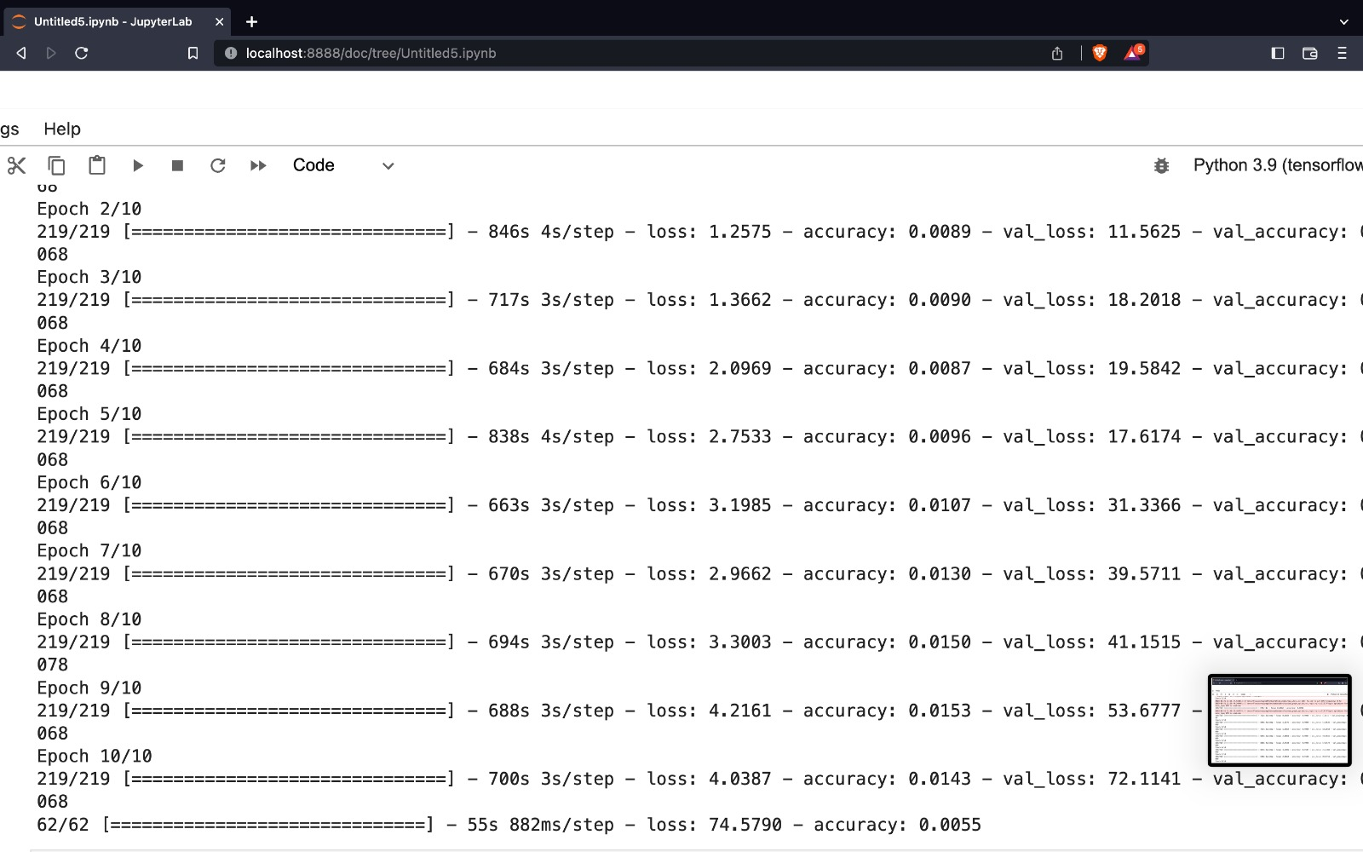
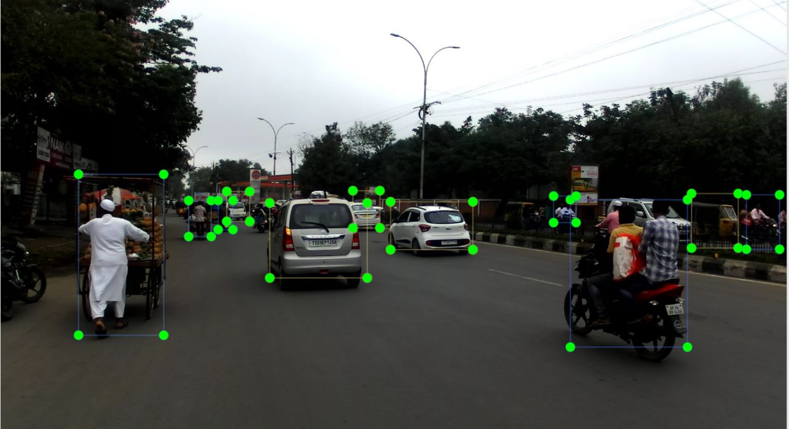
Output screenshots

